Slide 1
Deletion from a B Tree
Presented By: Colby Holmes

Slide 2
How to Delete from a B Tree
Case 1: If the key k is in node n and n is a leaf, delete the k from n.
Case 2: If the key k is in node n and n is an internal node, do the following:
a) If the child x that precedes k in node n has at least t keys, then find the predecessor k0 of k in the sub-tree rooted at x. Recursively delete k0, and replace k by k0 in n. (We can find k0 and delete it in a single downward pass.)
b) If x has fewer than t keys, then, symmetrically, examine the child y that follows k in node n. If y has at least t keys, then find the successor k0 of k in the subtree rooted at y. Recursively delete k0, and replace k by k0 in n. (We can find k0 and delete it in a single downward pass.)
c) Otherwise, if both x and y have only t-1 keys, merge k and all of y into x, so that n loses both k and the pointer to y, and x now contains 2t-1 keys. Then, free y and recursively delete k from y.

Slide 3
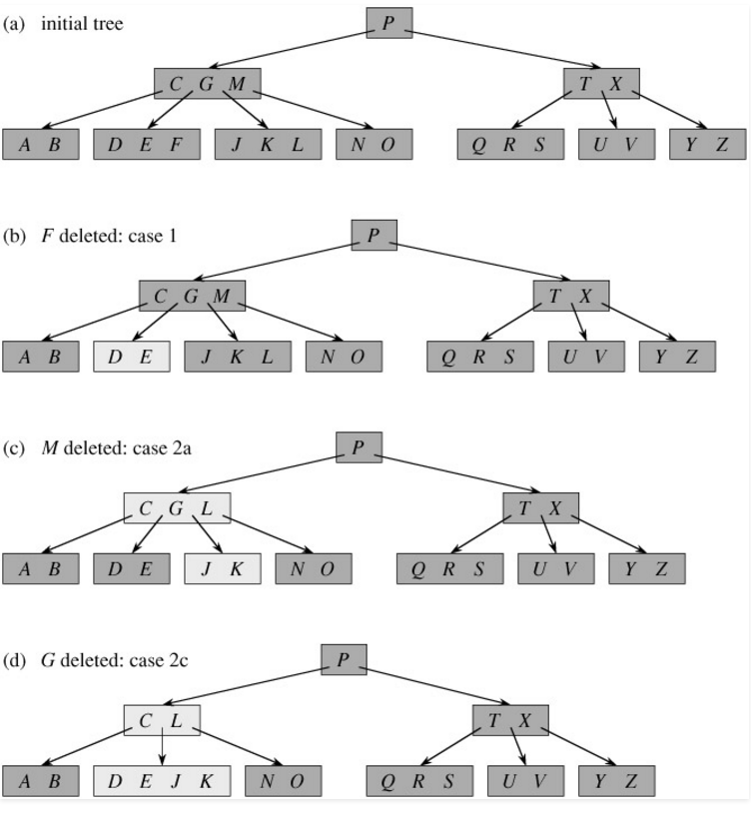
Visualization
(b) shows the deletion of a leaf
(c) shows the deletion of an internal node
And it's replacement by child "k0'
(d) shows the deletion of an internal node
and the merging of it's children into a single node

Slide 4
How to Delete from a B Tree (Cont.)
Case 3: If the key k is not present in internal node n, determine the root n.c(i) of the appropriate subtree that must contain k, if k is in the tree at all. If n.c(i) has only t-1 keys, execute step 3a or 3b as necessary to guarantee that we descend to a node containing at least t keys. Then finish by recursion on the appropriate child of n.
a) If n.c(i) has only t-1 keys but has an immediate sibling with at least t keys, give n.c(i) an extra key by moving a key from n down into n.c(i), moving a key from n.c(i) ’s immediate left or right sibling up into n, and moving the appropriate child pointer from the sibling into n.c(i).
b) If n.c(i) and both of n.c(i)’s immediate siblings have t-1 keys, merge n.c(i) with one sibling, which involves moving a key from n down into the new merged node to become the median key for that node.

Slide 5
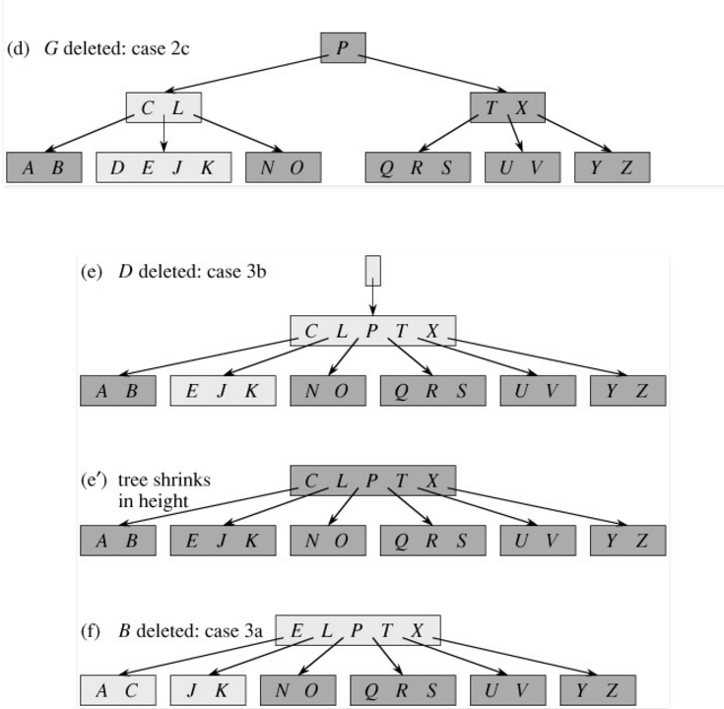
Visualization
Initial Tree
(e) shows the deletion of a leaf where the node containing it has >t keys. It requires a shift of the internal nodes (rebalancing) before it can check and delete the proper key
(f) shows the deletion of a leaf and a shift similar to that of a binary tree so that the nodes contain at least t keys.

Slide 6
Credits and Sources
"B-Tree | Set 3 (Delete) - GeeksforGeeks." GeeksforGeeks. N.p., 29 Oct. 2015. Web. 27 Oct. 2016.
Powerpoint Online
Colby Holmes (Me)

